Slide 1

Safe Use of ATM and Cards
(Debit and Credit)
(a presentation by MCPF Penang)
www.mcpfpg.org

Slide 2
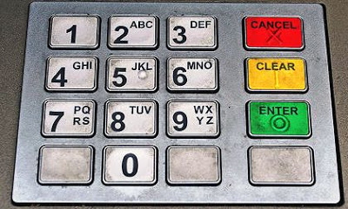
Safe Use of ATM and Cards
// Preventive Measures
www.mcpfpg.org
Be aware of where you keep your ATM, Credit and Debit Cards at all times;
For ATM and Debit Cards that involve a Personal Identification Number (PIN), keep your PIN a secret;
Don’t use your Address, Date of Birth, Phone
or NRIC Numbers as the PIN;
Memorize your PIN. Never write your PIN on
the ATM card, an envelope or other papers
that could easily be lost or seen;

Slide 3


Safe Use of ATM and Cards
// Preventive Measures
www.mcpfpg.org
Be observant of situation and people at and around the ATM machine. If there’s anything suspicious, go to another machine or return later;
Put away your cash immediately in your pocket, wallet or purse. Avoid displaying and counting your cash at the ATM machine;
Lock your car if you have to get out to use the ATM machine

Slide 4
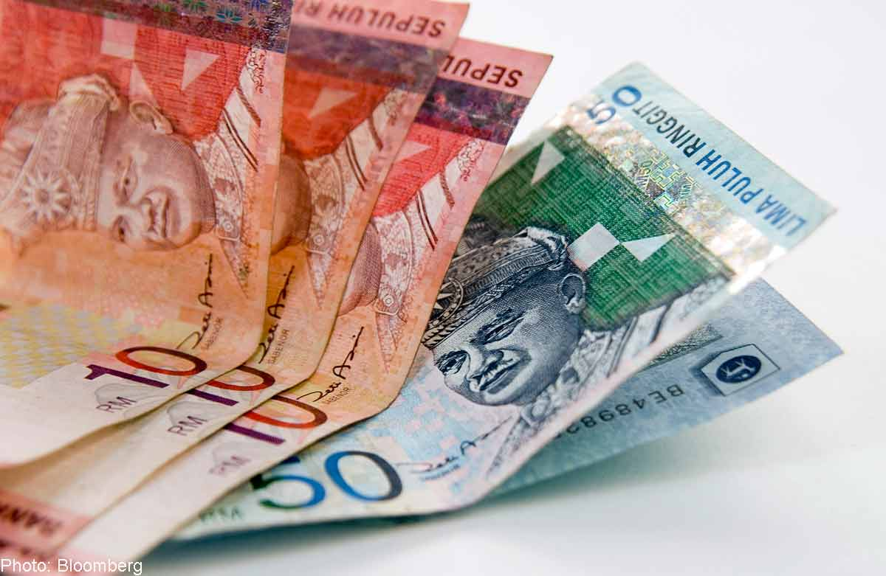
Safe Use of ATM and Cards
// Preventive Measures
www.mcpfpg.org
If possible, have someone accompany you;
Park in a well-lighted area/spot
as close to the ATM machine
as possible;
Do not use the ATM machine
if the lights are not working;
If the ATM machine is blocked by overgrown shrubs or trees, or any other objects, use another machine. Do feedback to the bank about this observation/concern!

Slide 5

Safe Use of ATM and Cards
// Preventive Measures
www.mcpfpg.org
Particularly important is you use
on-line banking;
Keep track of your transactions;
Check your:
  Current Balance/Transfers of Accounts;
  Debit from/Recent Withdrawals;
  Credit into/Recent Deposits;
  Current ATM and Debit Card Withdrawals & Purchases;
  Checks Movements (In and Out)

Slide 6
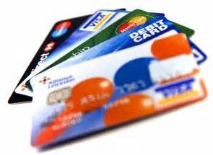
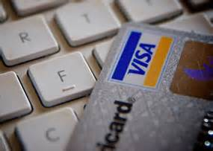
Safe Use of ATM and Cards
// If you lose your card(s)…
www.mcpfpg.org
Report the LOSS or THEFT to your ATM, Credit/Debit Card Issuer as soon as possible;
These Card Issuers have Toll-Free numbers and 24 Hours service to deal with such emergencies;
It’s a good idea to follow-up with a Letter and a
Branch visit;
Include your Account Number, when you noticed the card was missing, and the date you first reported the loss/theft.

Slide 7
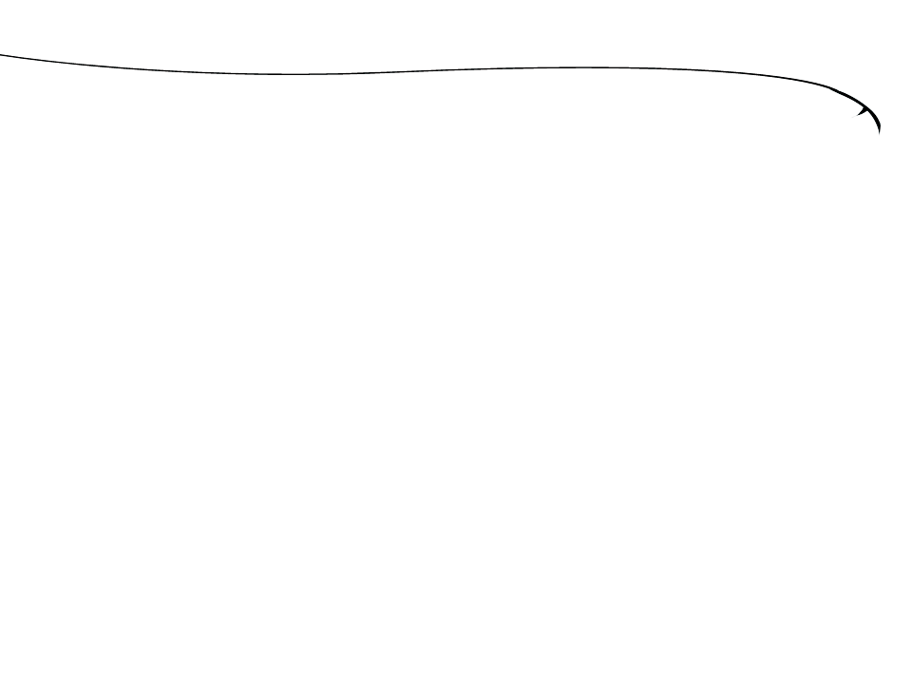
Safe Use of ATM and Cards
A short Awareness Presentation brought to you by:
Malaysian Crime Prevention Foundation
(Penang Chapter)
Visit us at www.mcpfpg.org for more information.

